Slide 1
Linear Algebra
Lecture 11

Slide 2
Segment II

Slide 3
Matrix
Algebra

Slide 4
Matrix
Operations

Slide 5
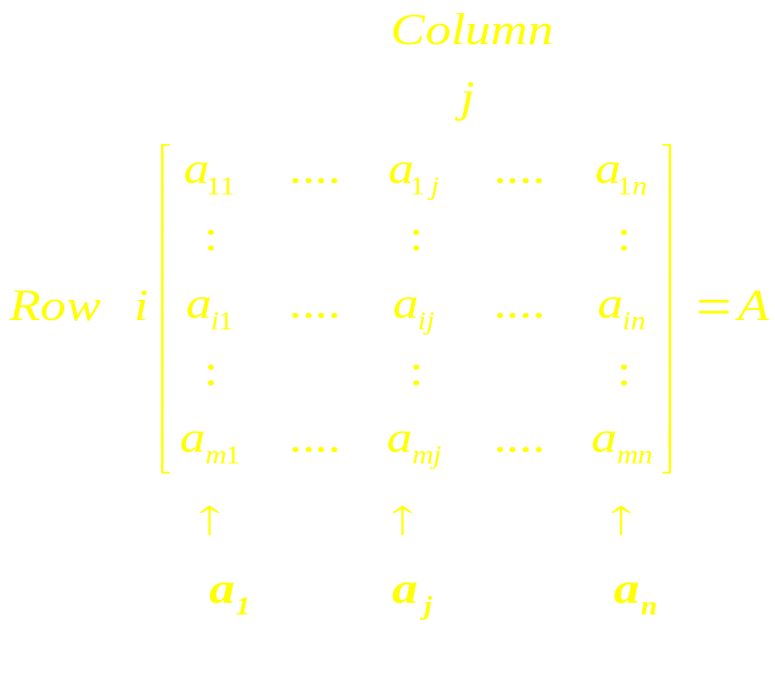

Slide 6
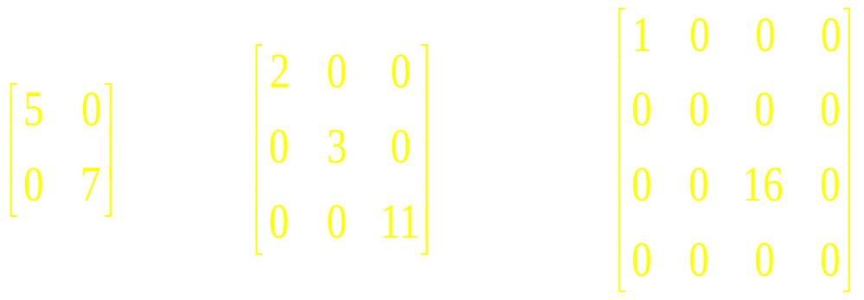
Diagonal Matrix

Slide 7
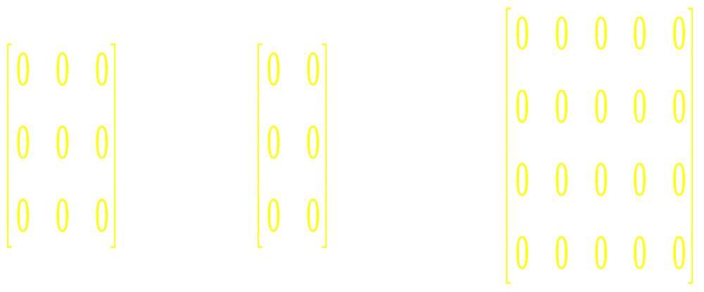
Zero Matrices

Slide 8
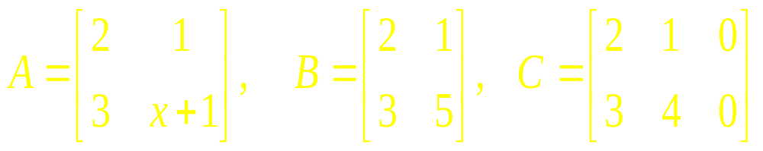
Example 1

Slide 9
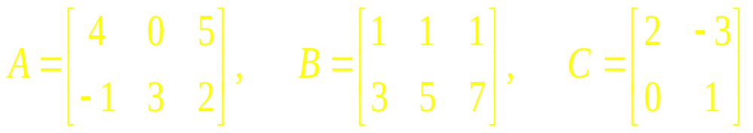
Example 2

Slide 10
Theorem 1
Let A, B, and C are matrices of the same size, and let r and s are scalars
A + B = B + A
(A + B) + C = A + (B + C)
A + 0 = A
r (A + B)= r A + r B
(r + s) A = r A + s A
r (sA) = (rs) A

Slide 11
Matrix
Multiplication

Slide 12
Examples

Slide 13
Row-Column Rule
for Computing AB

Slide 14
Finding Specific
Entries in a
Matrix Product

Slide 15
Examples

Slide 16
Finding Specific Rows
and Columns of a
Matrix Product

Slide 17
Examples

Slide 18
Properties
of Matrix
Multiplication

Slide 19
Theorem 2
A (BC) = (AB) C (assoc law)
A (B + C) = AB + AC (left dist law)
(B + C)A = BA + CA (right dist law)
r (AB) = (r A)B
= A(r B) (r scalar)
IA=A=AI (identity)

Slide 20
Power of
a Matrix

Slide 21
Transpose
of a Matrix

Slide 22
Quick
Revision

Slide 23
Linear Algebra
Lecture 11

